Slide 1






Named Access

Slide 2
Appendix
IP access
federated/SSO access
Known error messages

Slide 3
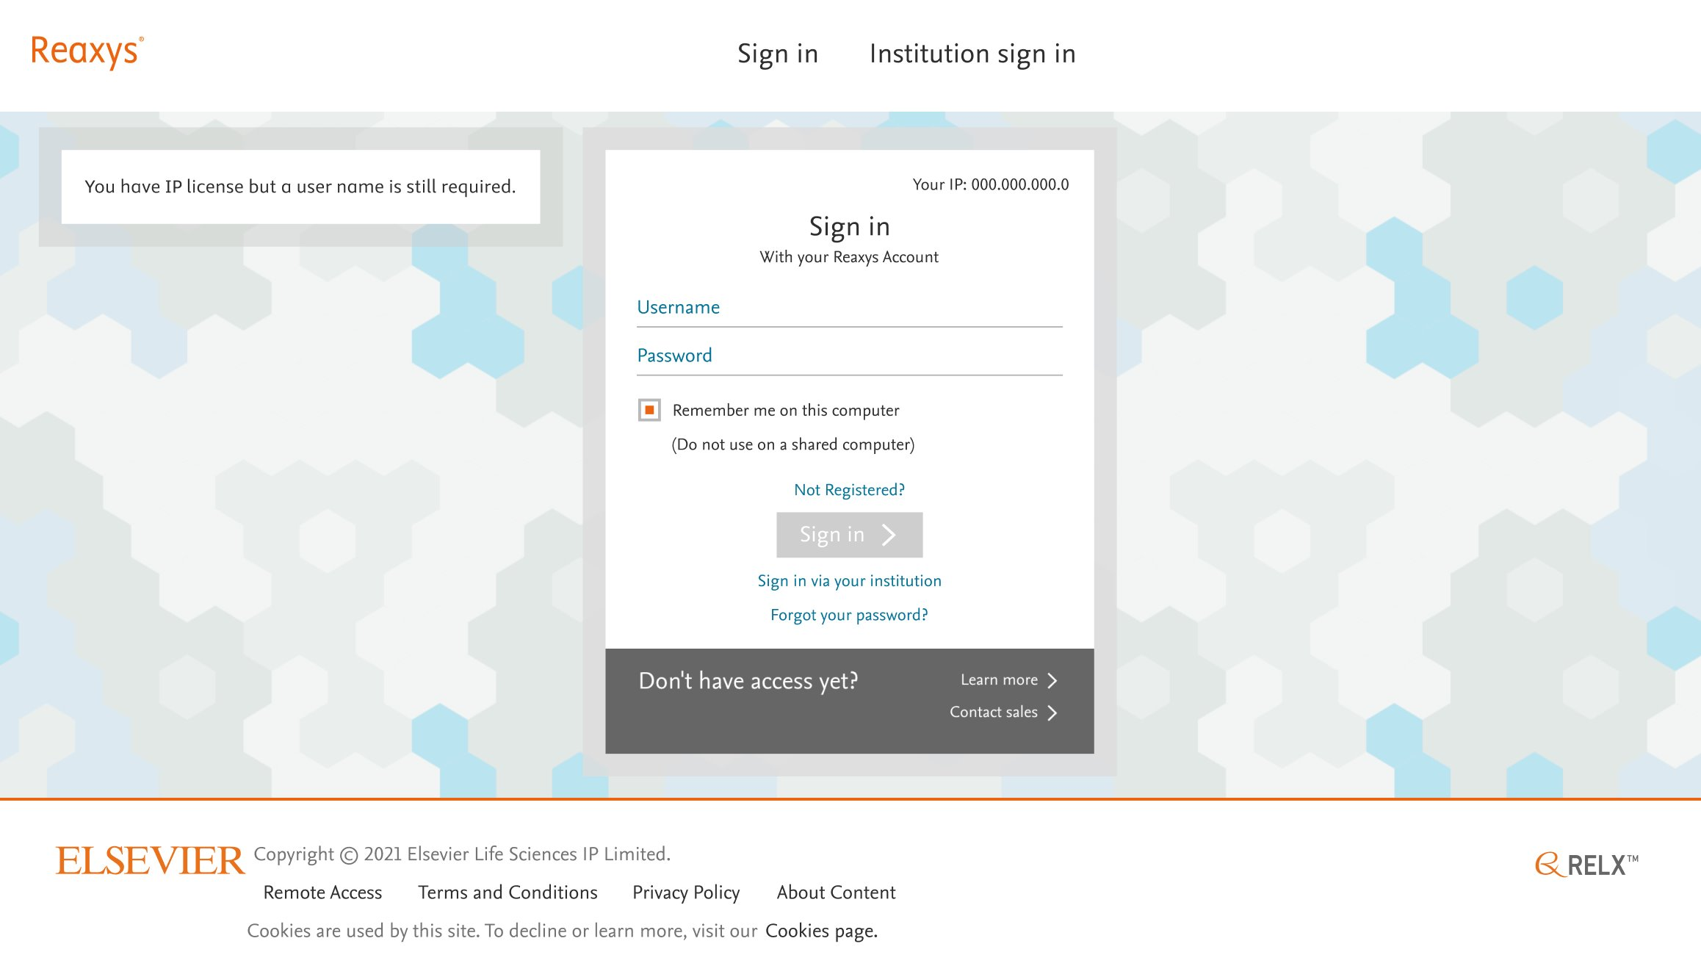

IP access with required login
Accessing Reaxys from company network
https://www.reaxys.com
Gets access to the specific company network Reaxys login page
User can register from this page
Message user credentials are required, can be customized
Registration option
Notes:
Other Text option: „You are required to be registered to use Reayxs. Login or click “Not Registered” to proceed.”

Slide 4
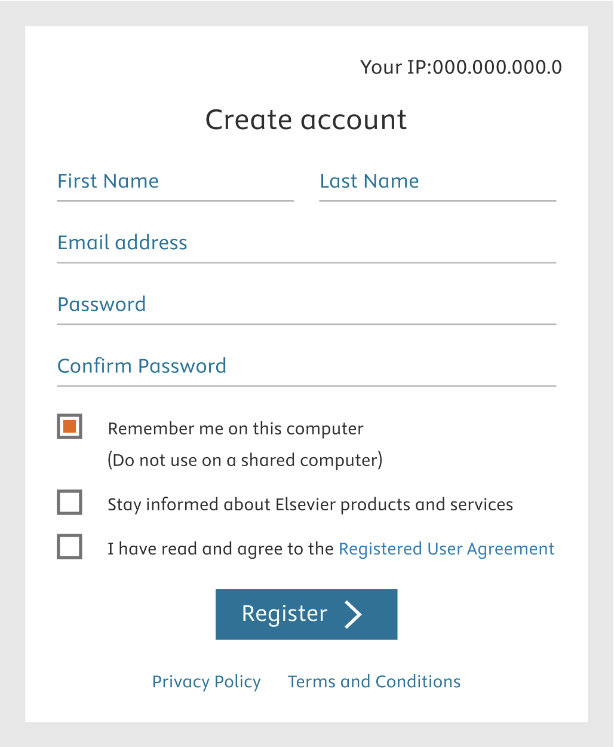
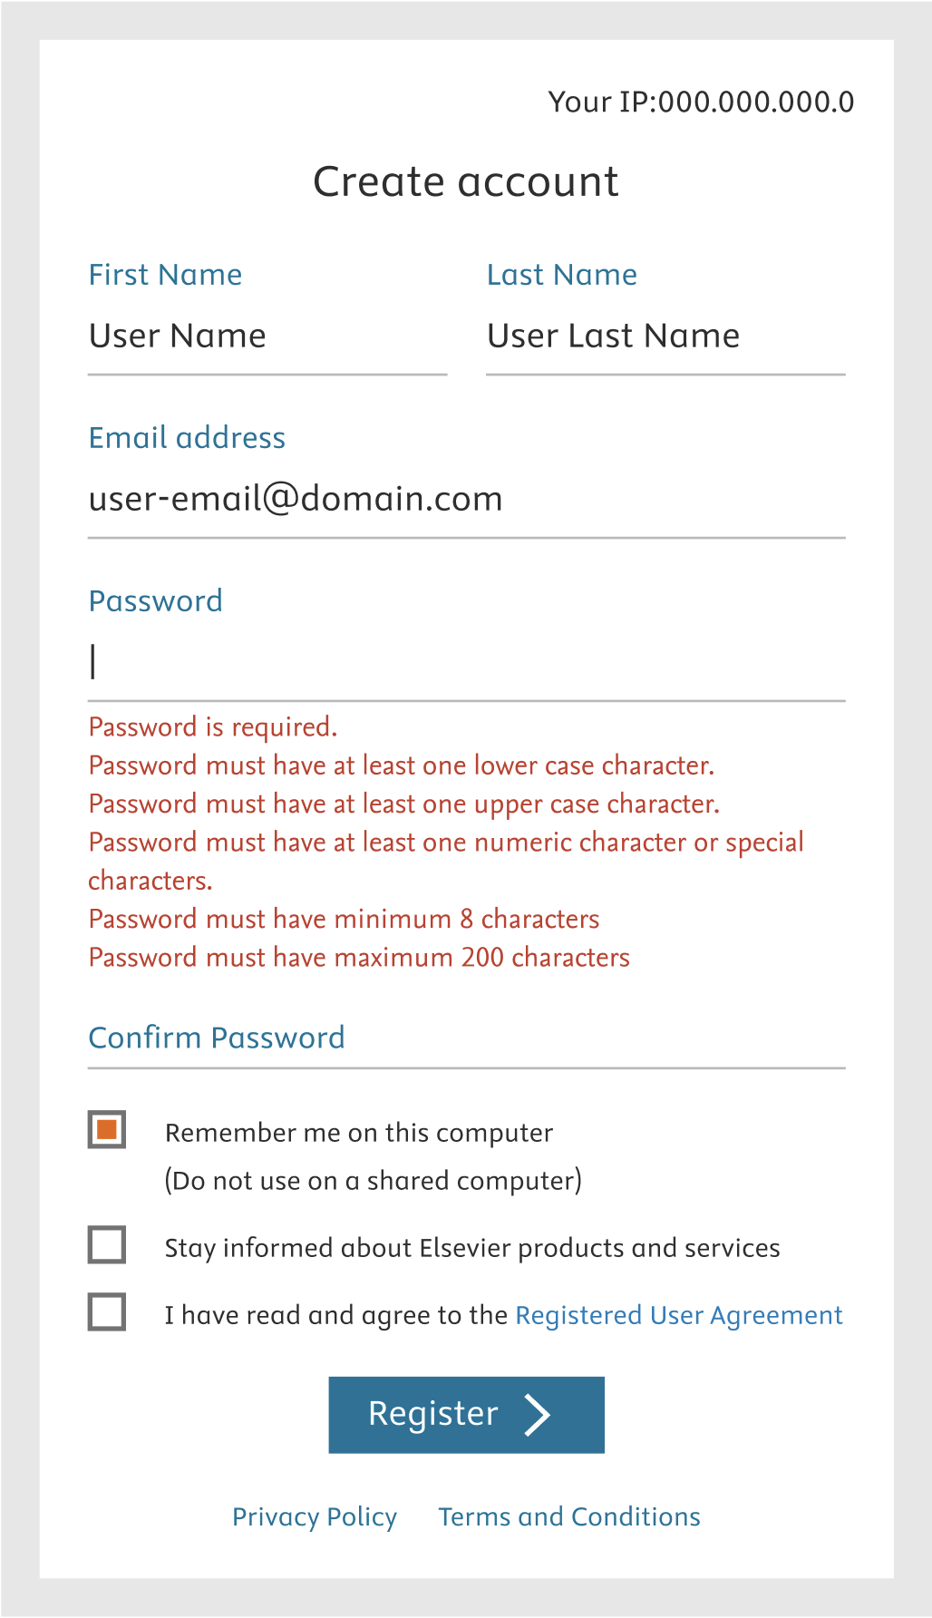
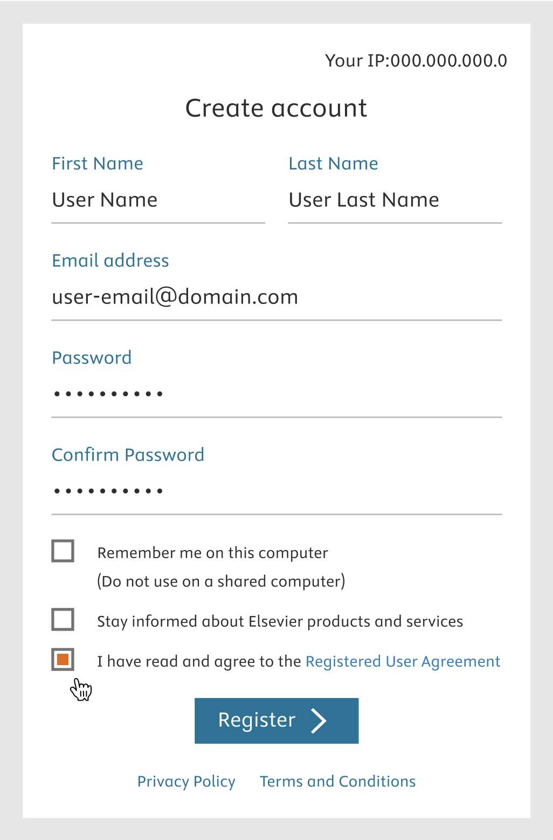
Registration process IP
User clicks on the Register button, completes the form, e.g. password requirements are displayed in red and vanish when they are met, check „I have read User Agreement“ and click register

Slide 5
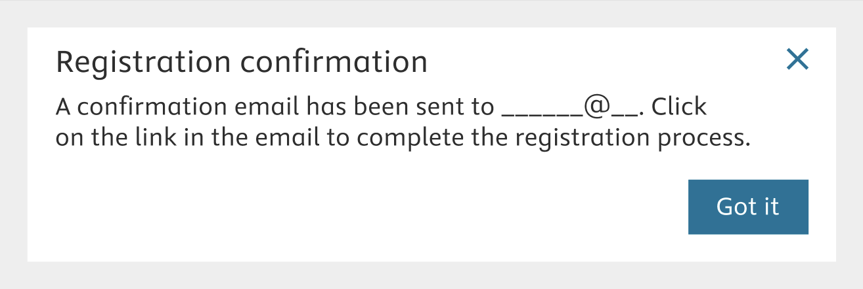
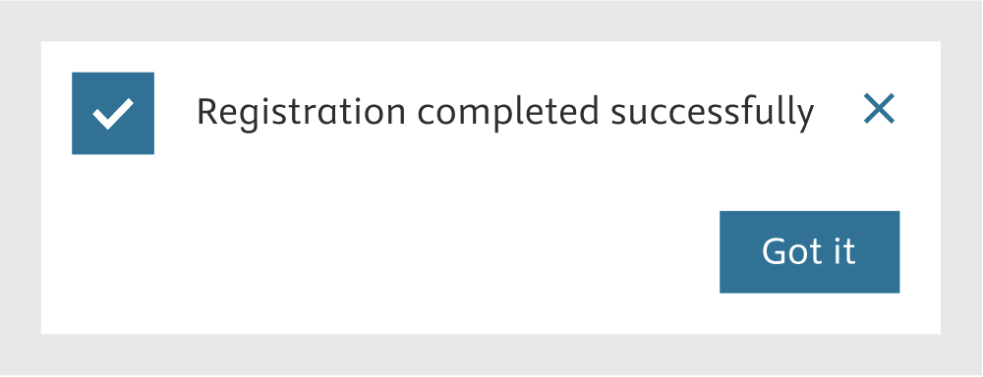
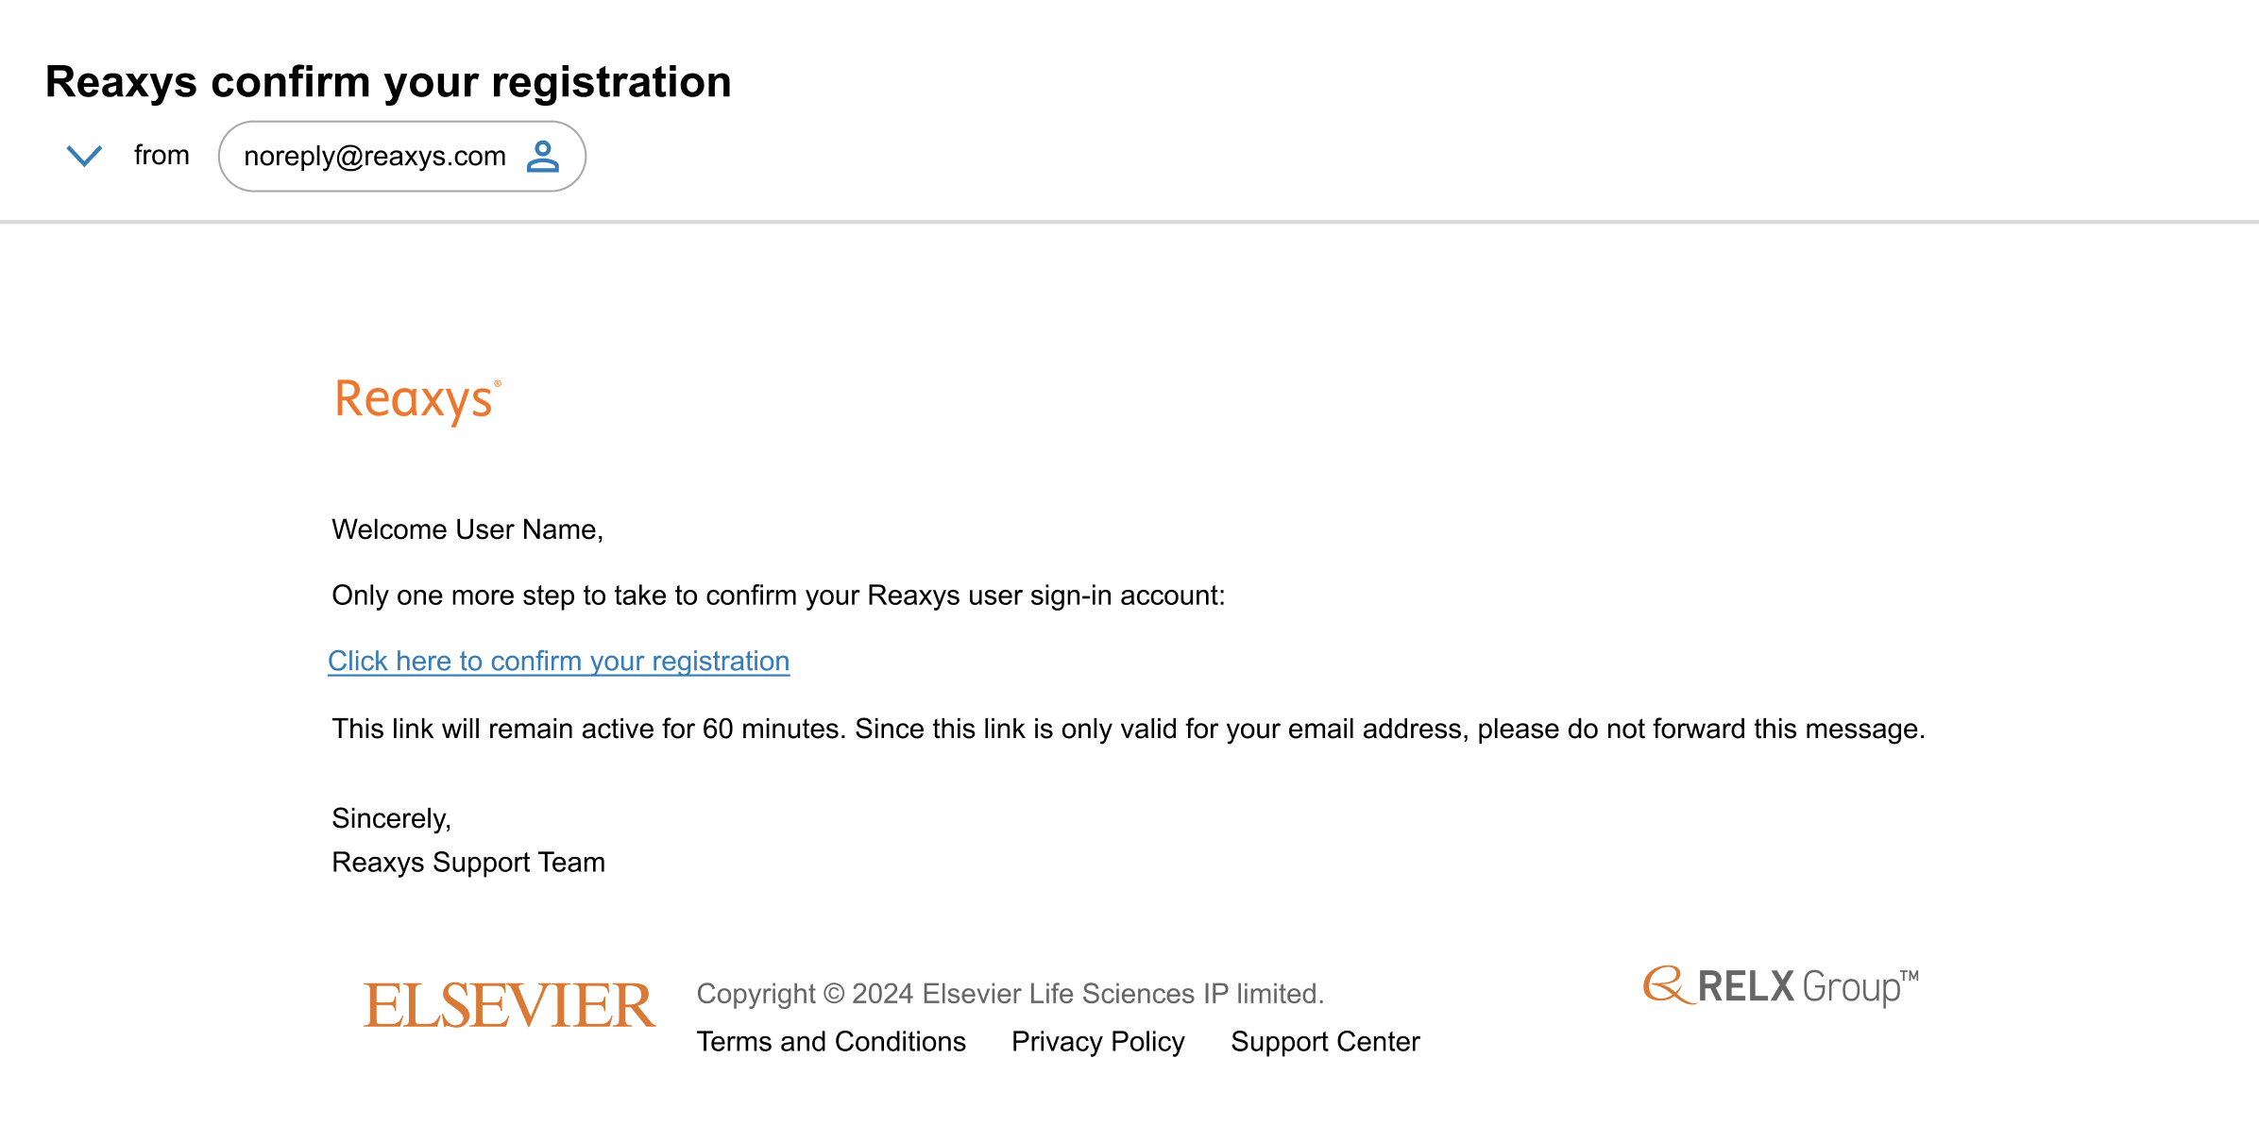

Registration process IP access -2
User receives the message that confirmation email is sent, open the confirmation email and click the link, user get the message Registration is successful and click „Got it“
1
3
2

Slide 6
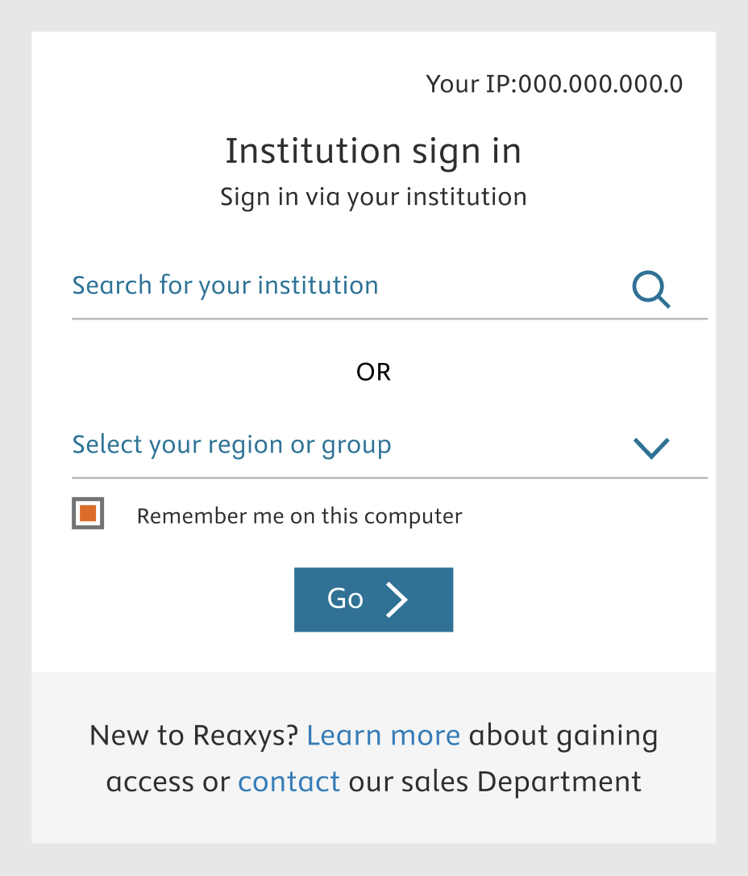


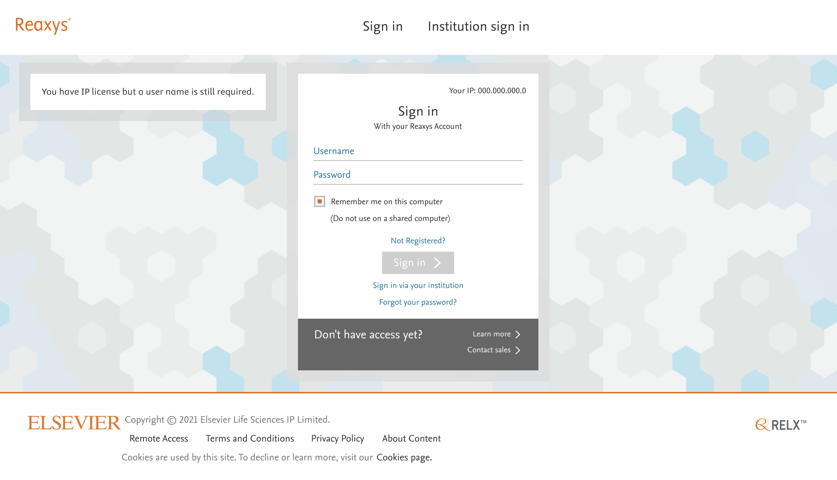

Required login federated/SSO access
Accessing Reaxys from everywhere
https://www.reaxys.com
Gets access to the Reaxys Login page
Select „Institution Sign In“
Search and select Institution
Click „Go“
2
3
Option 1
1
Option 2

Slide 7
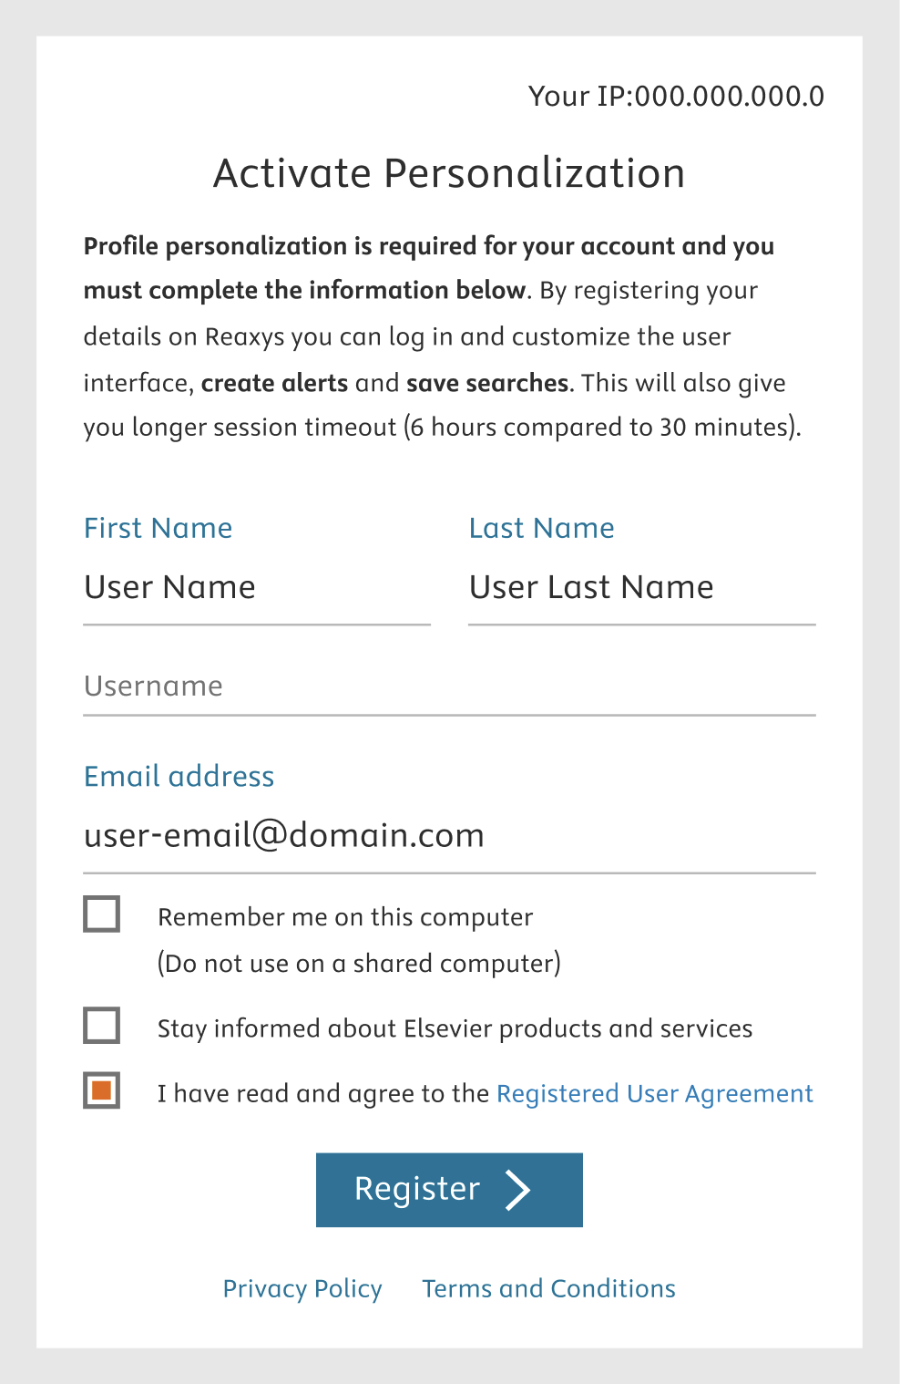
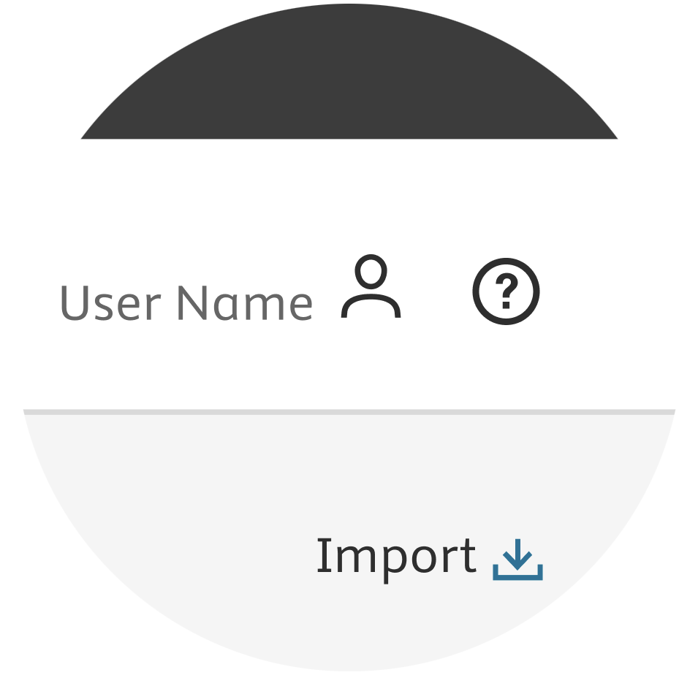
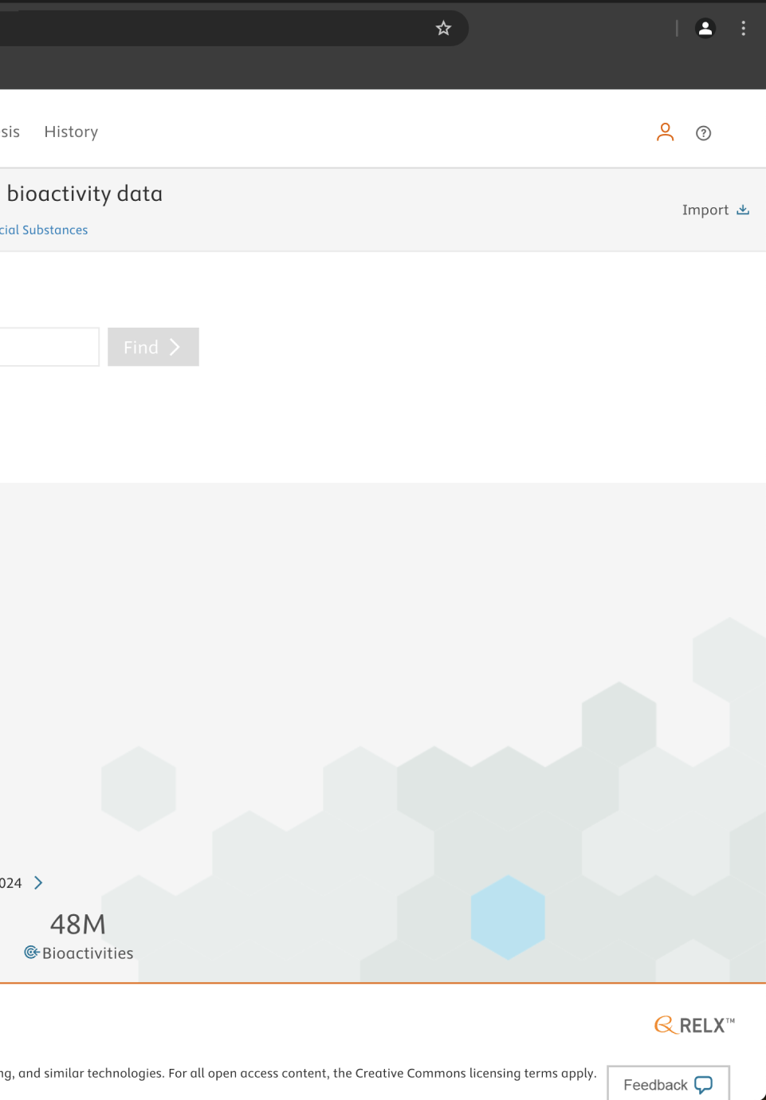
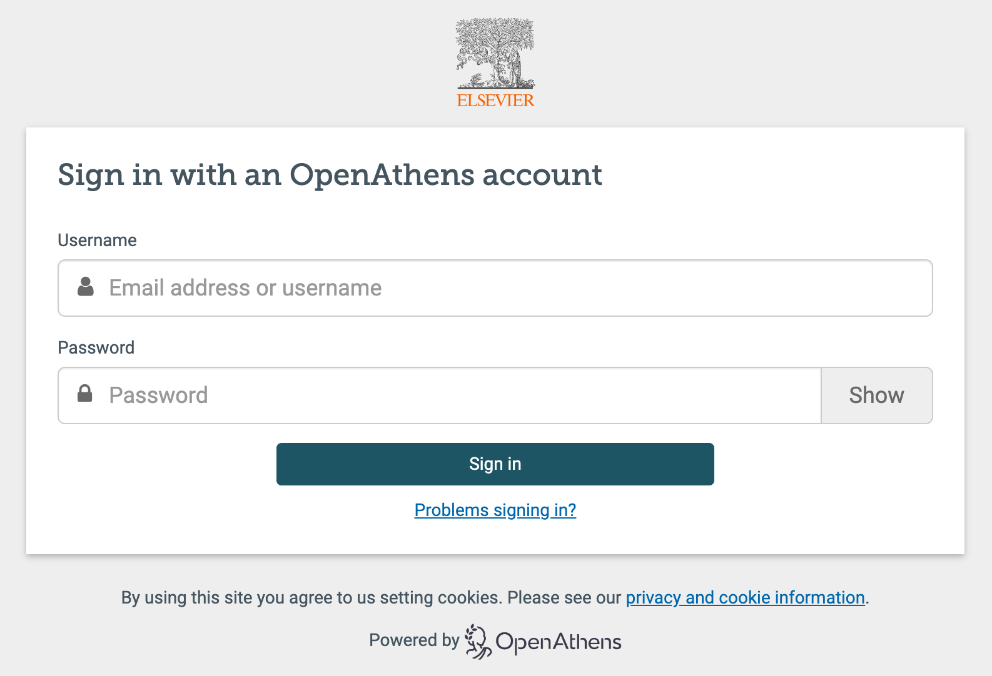
Personalization process federated access- 1
User signs in with their IDP:
for a „new“ user the personalization page will pop up
a user with existing profile will be directed to the query page
User with profile created in other Elsevier product
New user

Slide 8
Personalization process federated access-2
User receives the message that confirmation email is sent, open the confirmation email and click the link, user get the message Registration is successful and click „Got it“
1
3
2

Slide 9
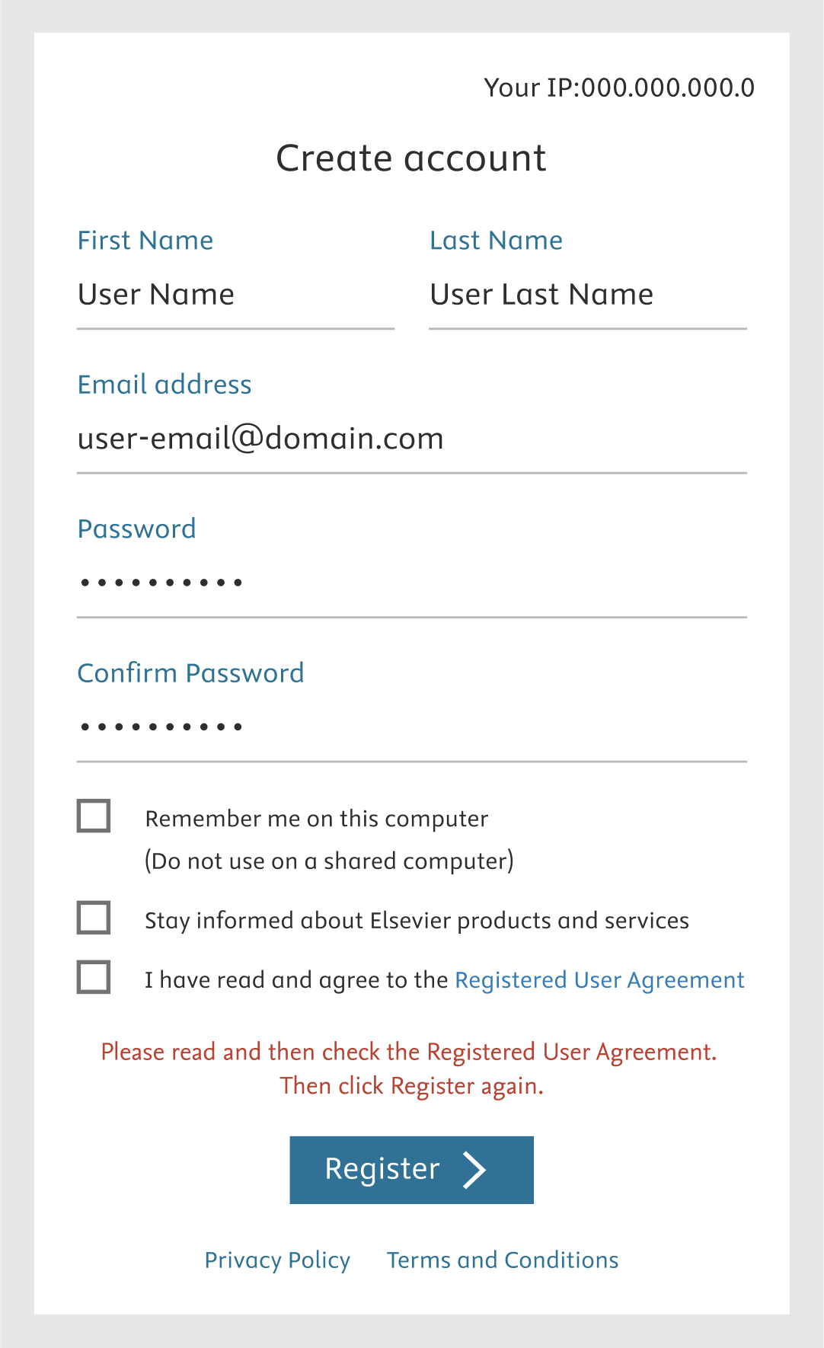
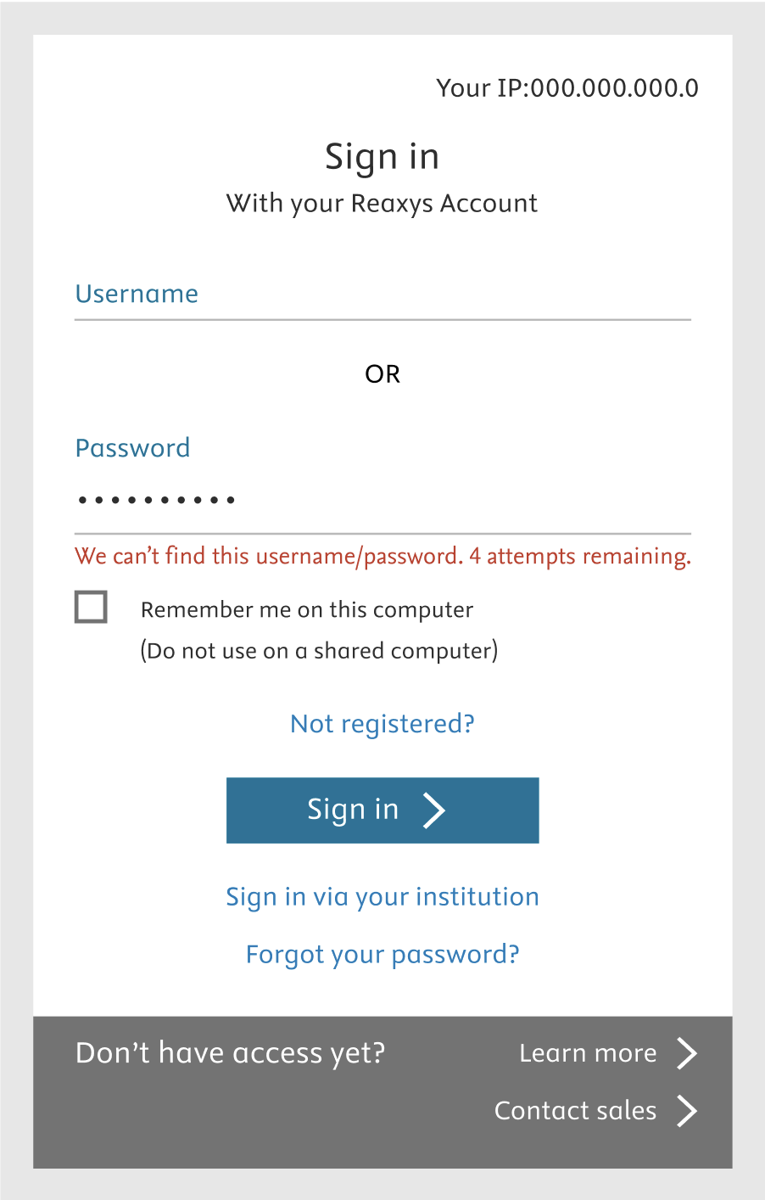
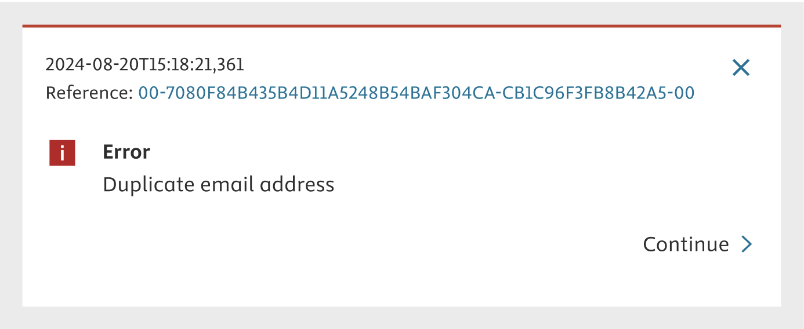
Known error messages
User forgets to click on user agreement terms
User selects the according checkbox
User tries to register again
User logins in with his credentials or uses the forgotten password feature
User used wrong user name/password
User re-enters the credentials or uses the forgotten password feature

